Slide 1
Category review: Chips
June 2023
By Ashlesh Khajbage
Retail Analytics
Brand note: If client logo is not required, use alternate title page layout right click slide thumbnail > Layout > Title

Slide 2
Notes:
To view Privacy video explaining how important data privacy is to Quantium, please click here: https://www.youtube.com/watch?v=Zq1QDAkoRzUor here Q:\Company Reference\Brand & Design\Brand videos\Q Privacy.mp4At Quantium, we believe that data is the behavioural footprint of humanity and that it has to be treated with the utmost care and responsibility. Histories, attitudes, indeed lives are stored within it in ways that aren’t always apparent – and that’s what makes its potential so powerful. To work with it responsibly, sensitively, we set ourselves the highest data privacy protection and governance standards. We have spent 17 years perfecting privacy-by-design and secure-by-design principles. Central to this is not holding any personally identifiable information about people – we neither receive it, and put the necessary protections in place to be unable to decipher it. Every aspect of handling data is safeguarded: from its de-identification, to its encryption – data security is paramount and of the highest grade. We pride ourselves on gaining the trust of iconic organisations around the world through years of securely working with their data, and in turn the trust that builds with their stakeholders.

Slide 3
Executive summary
• Young and middle-aged singles and couples in the mainstream group spend the most money per purchase in terms of chips.
• Older Families (Budget) are the most likely to make purchases, followed by Young Singles and Couples (Mainstream), and Retirees (Mainstream), who together account for 25% of all sales.
• For all divisions, the most popular chip size is 175 gr, followed by 150 gr.
• The most popular brand of kettle in all retailers is Chips Brand.
• The only segment where Doritos is the most frequently purchased brand, with Smiths being the case for all other segments, is young and middle-aged singles and couples.
• Before Christmas, there is a significant surge in chip transactions, which might be advantageous with the aid of special offers.
01
Chips Category Review
02
Store Analysis
• When compared to the control store, trial stores 77 and 86 saw a significant increase in total sales and customer count during the experiment.
• Trial store 88 also increased, although not as much as stores 77 and 86.

Slide 4
01
Customer Analytics

Slide 5
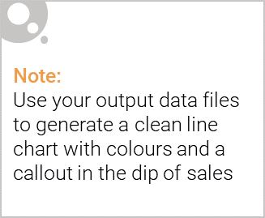
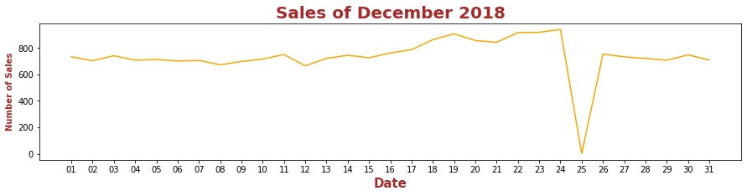
• The day with no transactions is a Christmas day, when the store is closed, thus there is a drop in sales on December 25th because the stores were closed.
• Sales rise gradually as Christmas approaches, then fall back to early December levels on New Year's Eve.

Slide 6

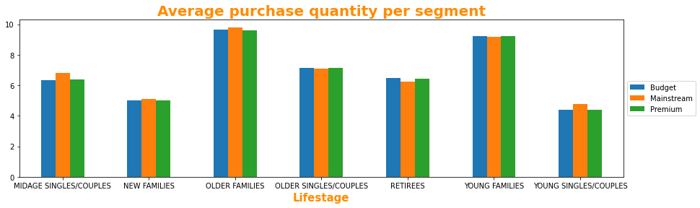
• Budget older families, Mainstream young singles/couples, and Mainstream retirees accounted for the majority of sales. Contributing 25 percent of overall sales revenue
• The average purchase unit per unique client is highest in the Older and Young Family segments.

Slide 7
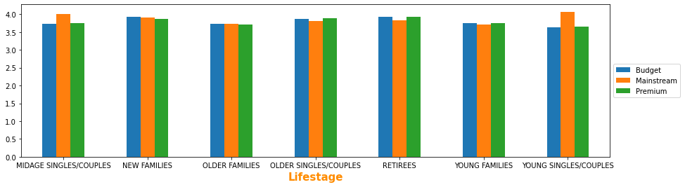

Slide 8
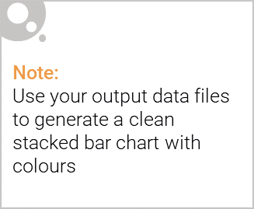
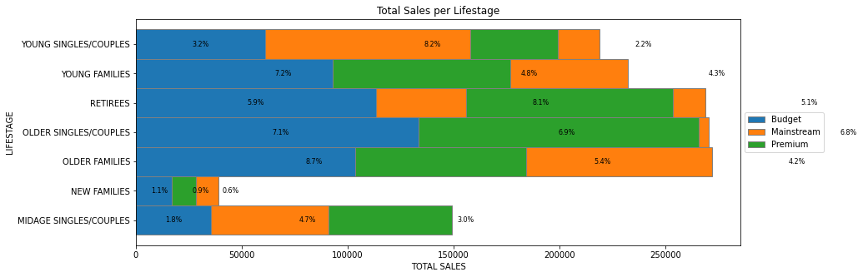
Editable (delete this)
• Budget older families, Mainstream young singles/couples, and Mainstream retirees accounted for the majority of sales. Overall, elderly clients outnumber younger customers.
• Non-premium customers spend more money than premium customers.

Slide 9
02
Trial store performance

Slide 10
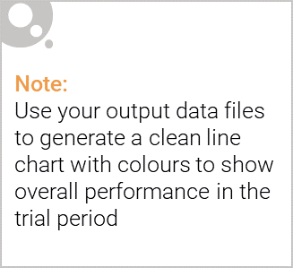
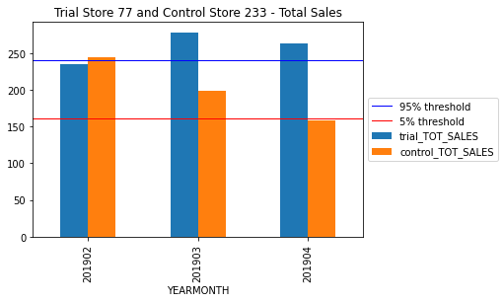
The sales of Trial store 77 in February, March, and April surpass the 95 threshold of the control store. This pattern is also observed for store 86 during the same three trial months.
However, the increase in sales for trial store 88 is not significant.

Slide 11
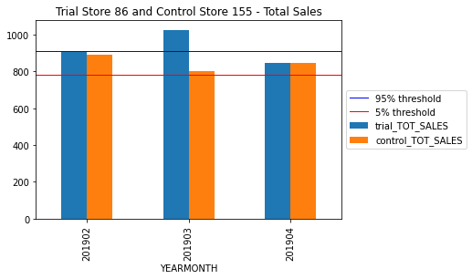

Slide 12
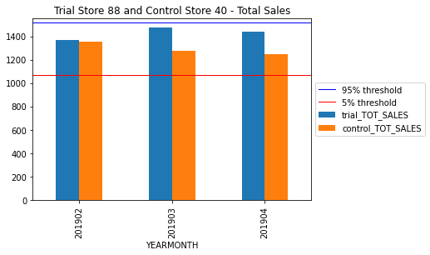

Slide 13
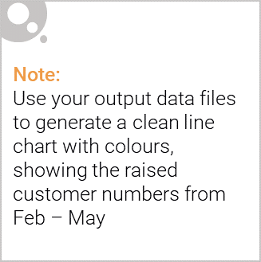
We can see that Trial store 77 sales for Feb, March, and April exceeds 95% threshold of control store. Same goes to store 86 sales for all 3 trial months.
Trial store 77: Control store 233
Trial store 86: Control store 155
Trial store 88: Control store 40
Both trial store 77 and 86 showed significant increase in Total Sales and Number of Customers during trial period. But not for trial store 88. Perhaps the client knows if there's anything about trial 88 that differs it from the other two trial.
Overall, the trial showed positive significant result.

Slide 14
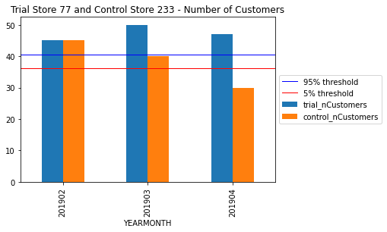

Slide 15
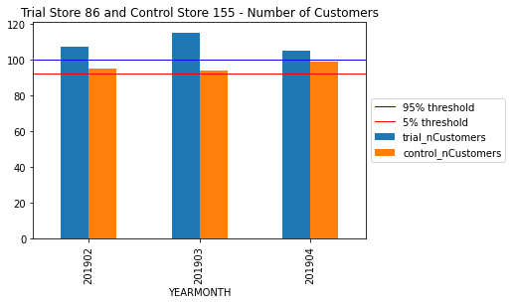

Slide 16
